Slide 1
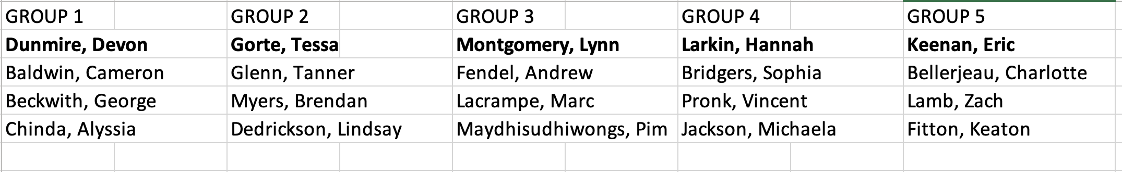
Please find your group before class!

Slide 2
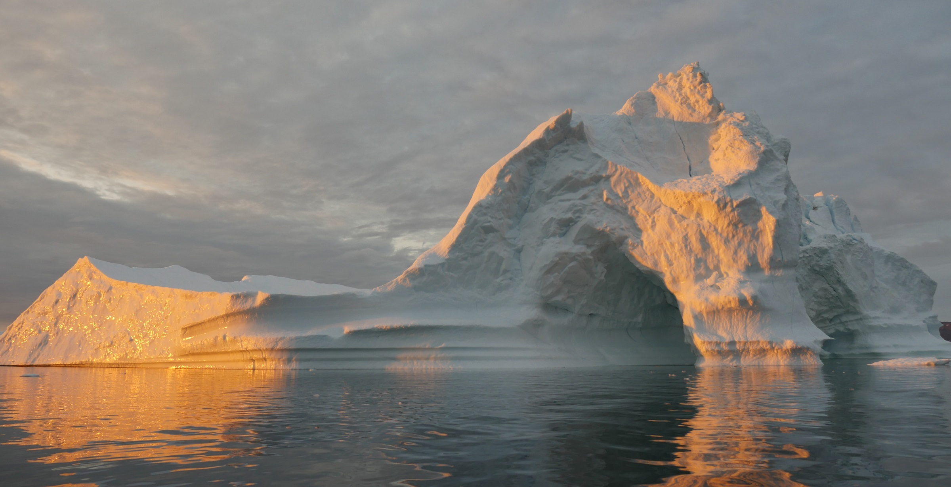
Ice Sheets & Climate
ATOC 4500/7500 - Spring 2020 - Prof. Jan Lenaerts

Slide 3
Ice Sheets & Climate
Lab 2: Analyzing weather data on ice sheets
ATOC 4500/7500 - Spring 2020 - Prof. Jan Lenaerts

Slide 4
Announcements
Joining field trip? Decide by class on Wednesday!
Homework 1 grading delayed – grades will be on Canvas by Wednesday, answer key on Slack.
Homework 2 due next week Wednesday 1.30 pm

Slide 5
‘Heat wave’ on Antarctica
Source: Brooke Medley (NASA)

Slide 6
Surface energy balance
Melt = SW_{net} + LW_{net} + SHF + LHF + G
Melt is usually zero (T_{sfc} < melting point)
When T_{sfc} = melting point, excess energy goes to melt (or ‘negative’ energy to refreezing)

Slide 7
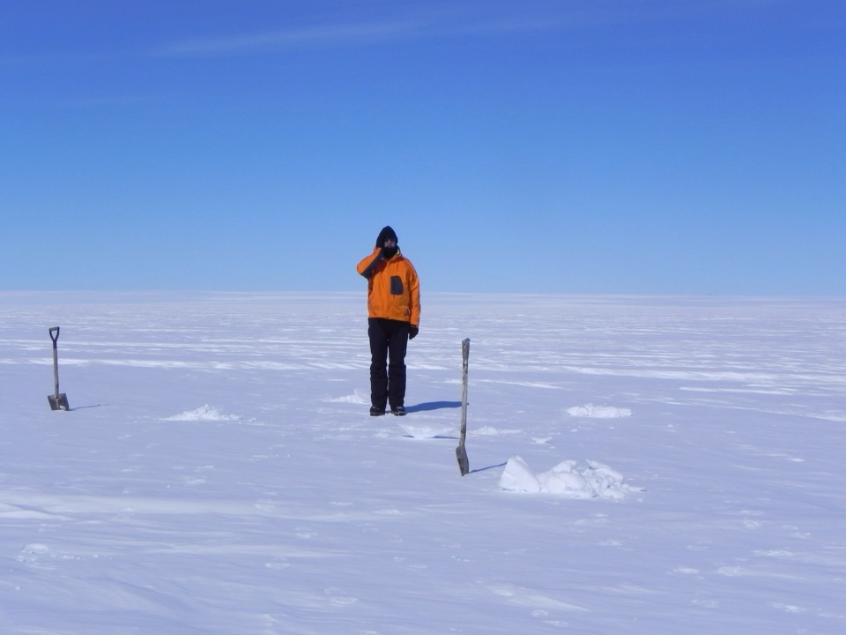
Automatic Weather Stations

Slide 9
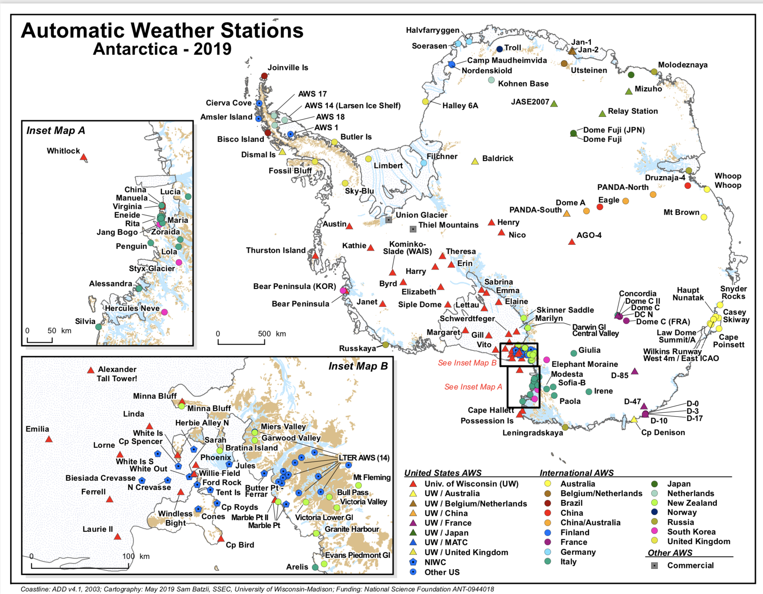

Slide 10
Outgoing longwave radiation
LW_{out} = εσT⁴
ε = surface emissivity (depends on surface type, here we use
ε = 0.97, which is typical for snow/ice)
σ = Stefan-Boltzmann constant (=5.67 x 10⁻⁸ W m⁻² K⁻⁴)
T = surface temperature (K)

Slide 11
Some tips to facilitate group work
Create and use a group Slack channel
Back up your files/code/etc. – use Google Drive, Dropbox, etc.
Ask questions to group and discuss respectfully
Explaining something to your group/another student can be super helpful, not only for them, but also for you!
Don’t hesitate to ask questions to me!
Lab = group work // Homework = individual work

Slide 12
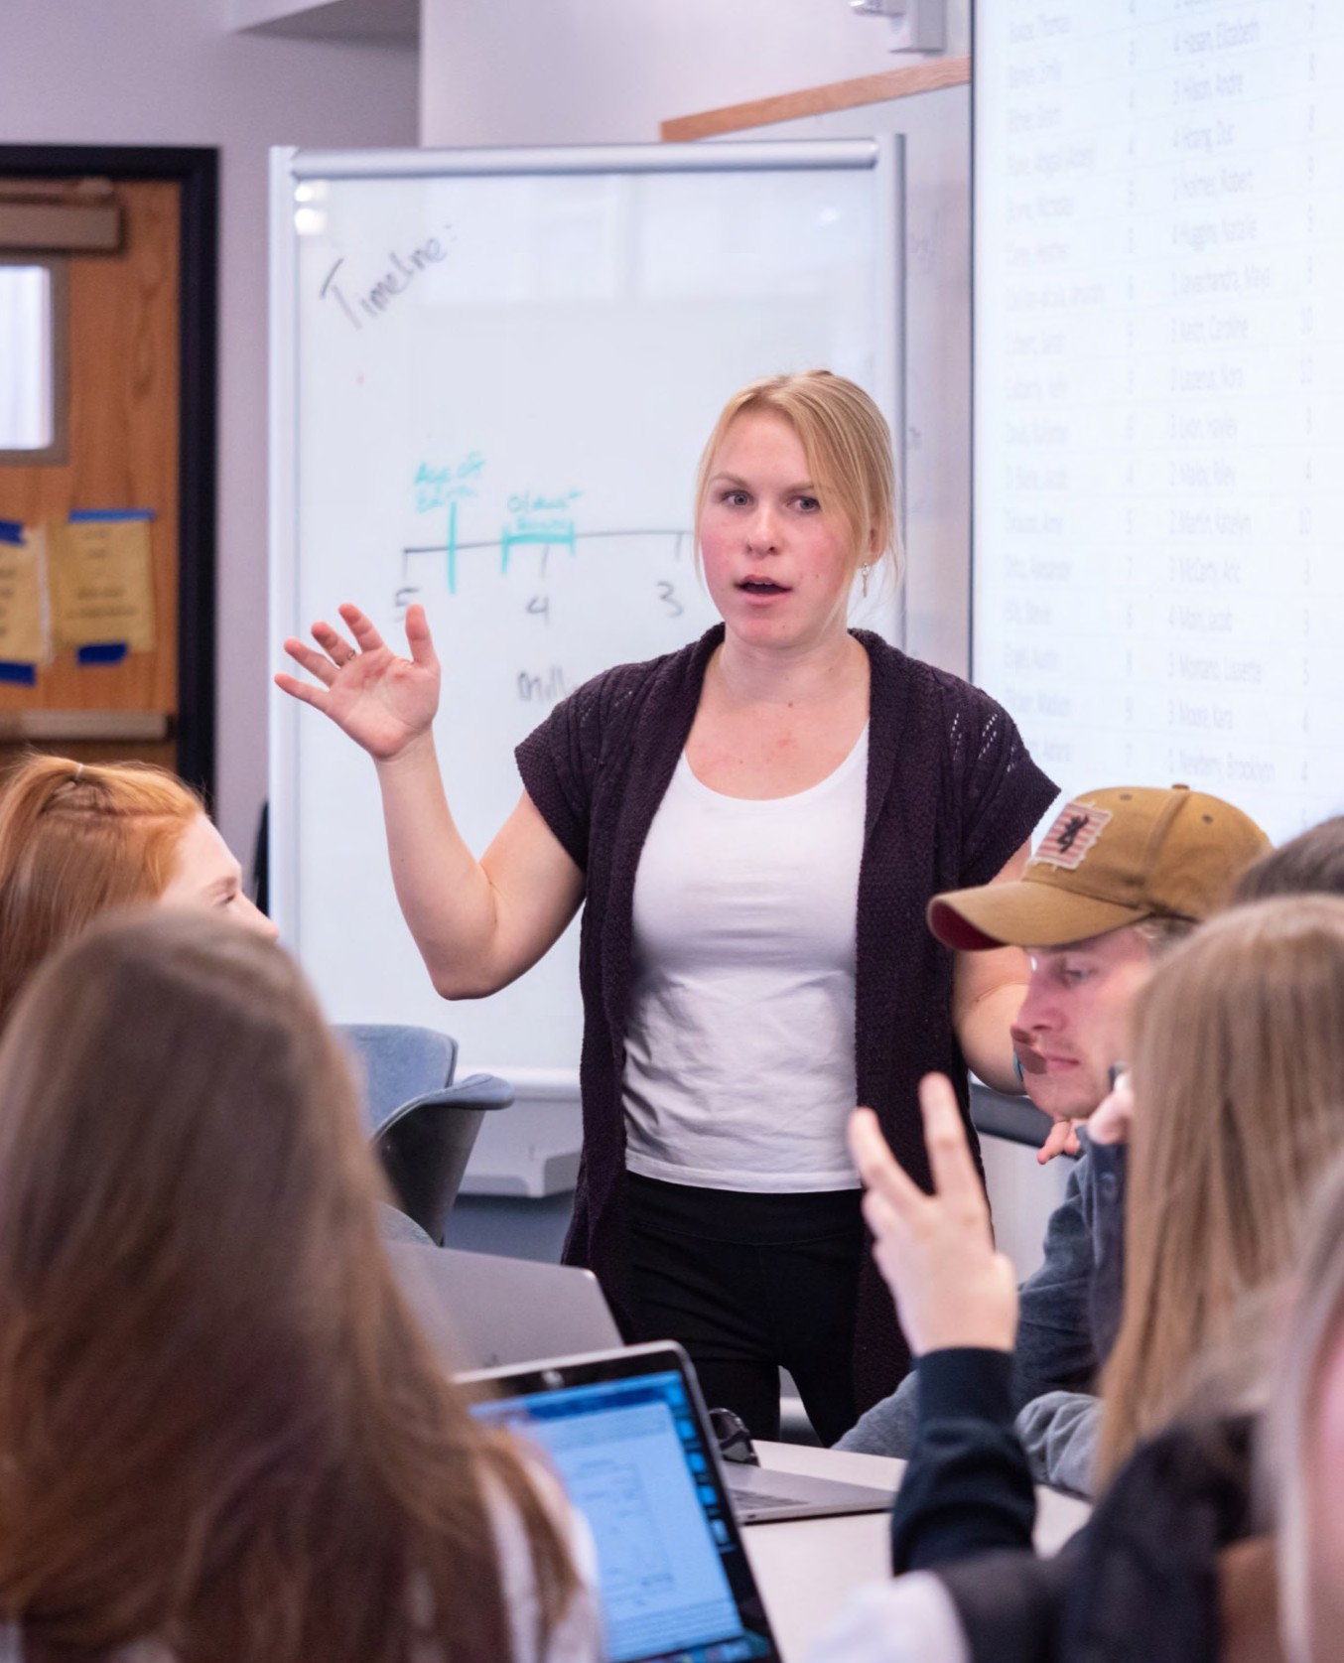
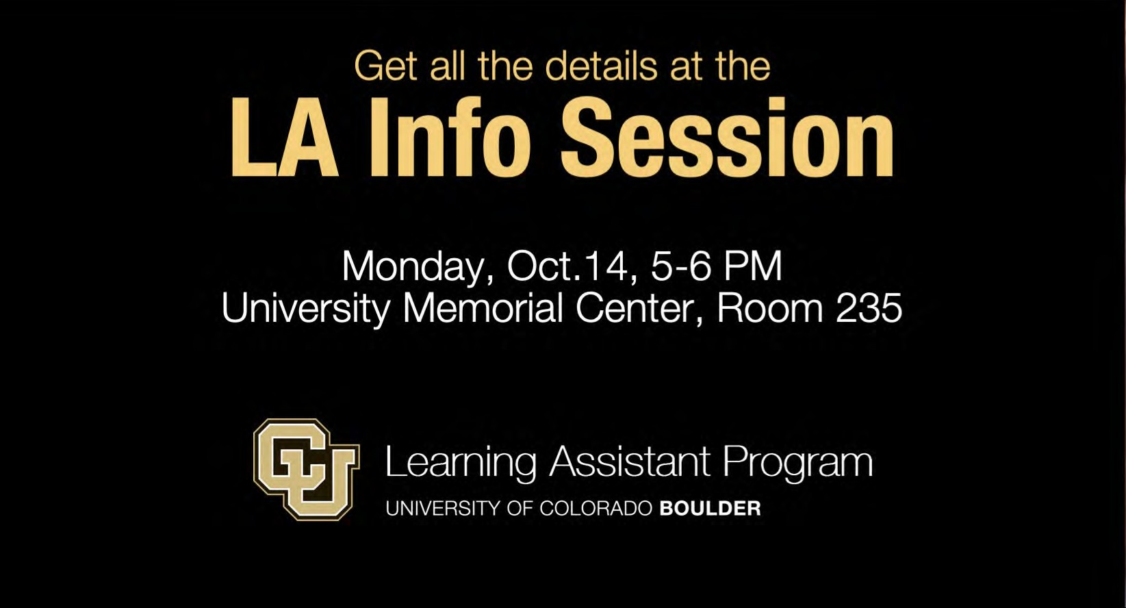
BECOME A LEARNING ASSISTANT FOR FALL 2020
Being able to discuss my concerns with my classmates and LA Mentor really helped me feel more confident in my abilities as an LA.”
— Thomas Windham, alumnus (PhD Psych’75), past student and friend of the Nilons
Apply March 2 – 9
at LearningAssistantAlliance.Org
Thursday, Feb. 27, 5-6 p.m.

